Slide 1
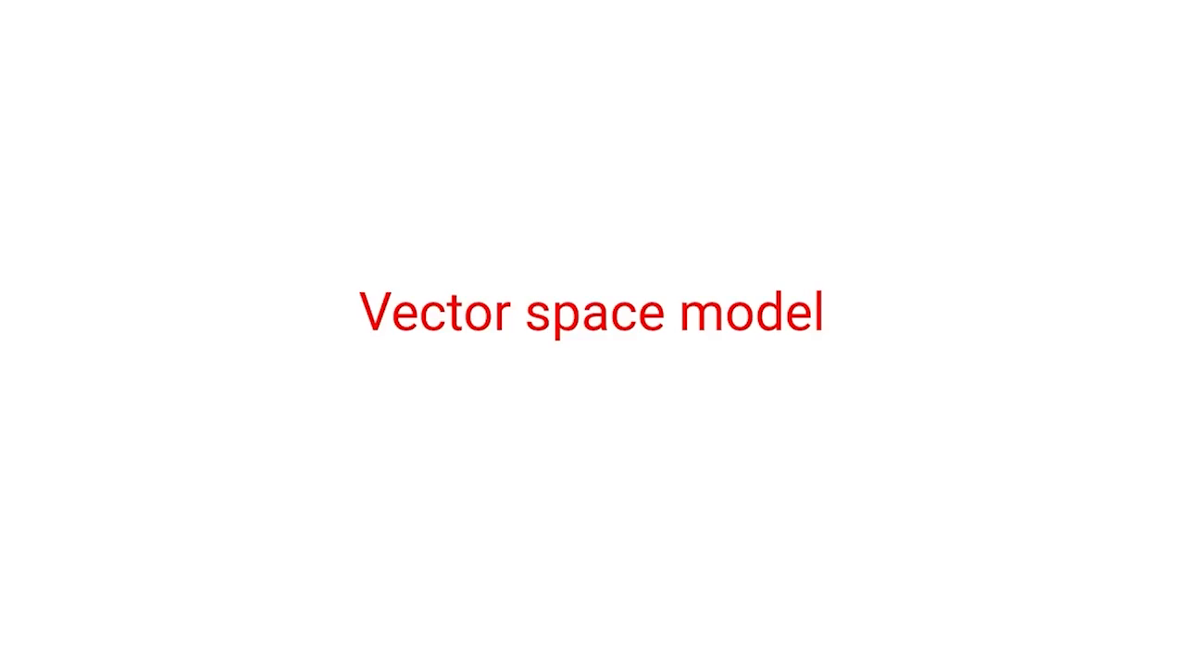

Slide 2
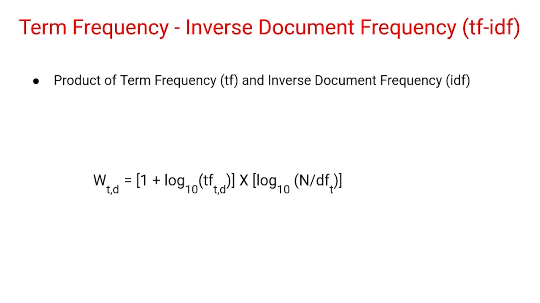

Slide 3
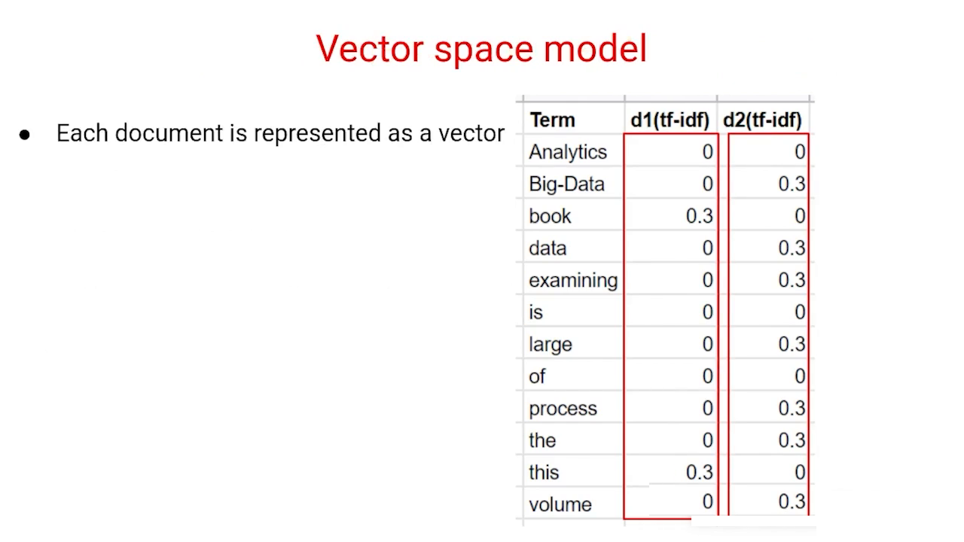

Slide 4
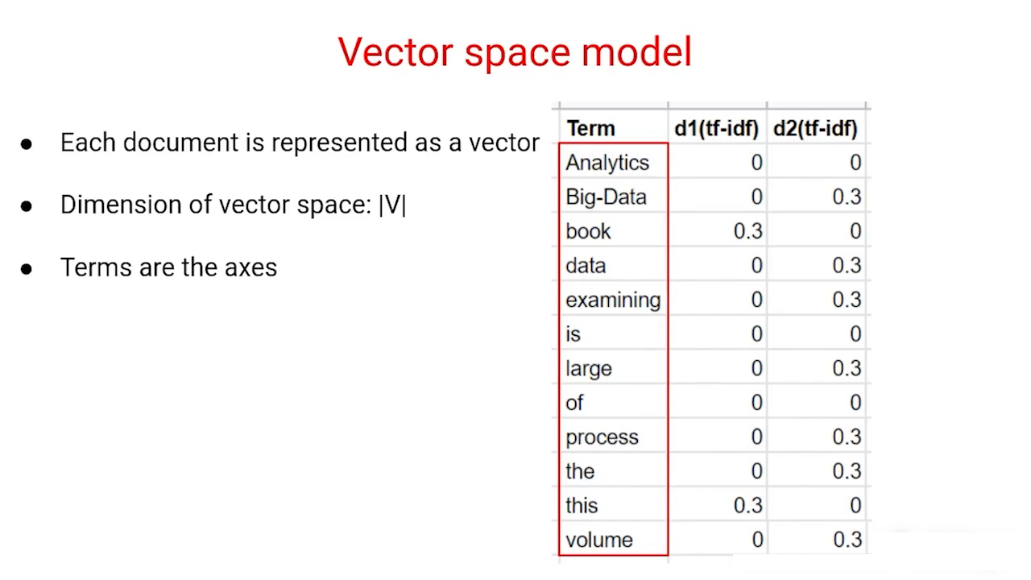

Slide 5
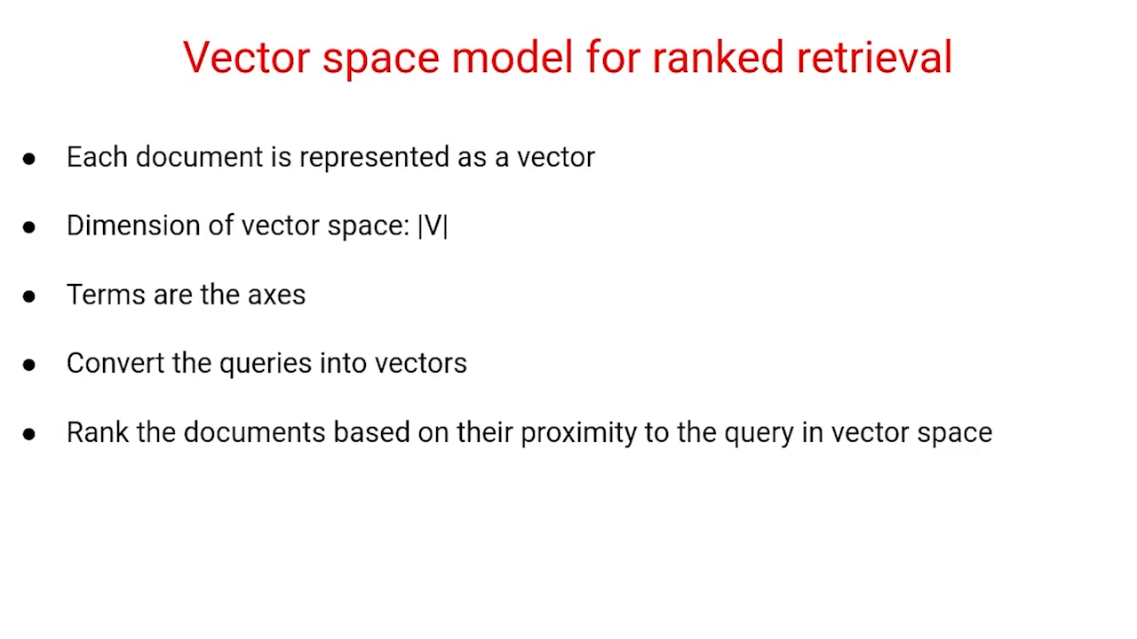

Slide 6
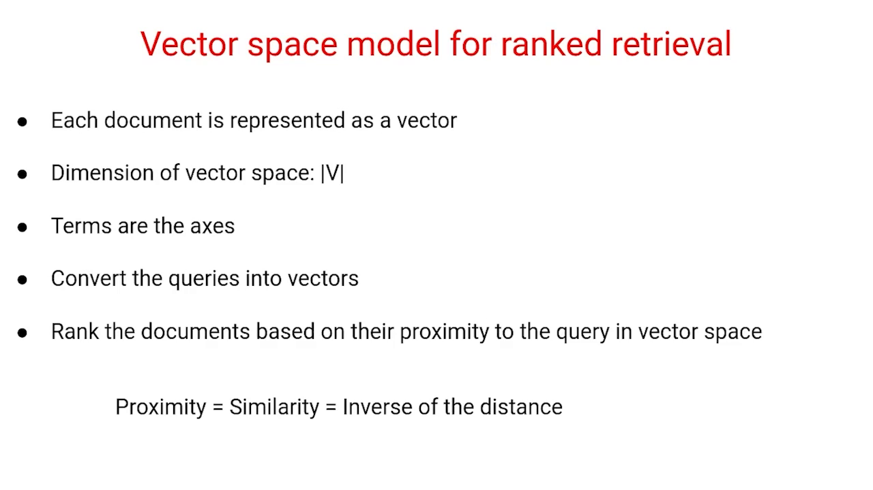

Slide 7
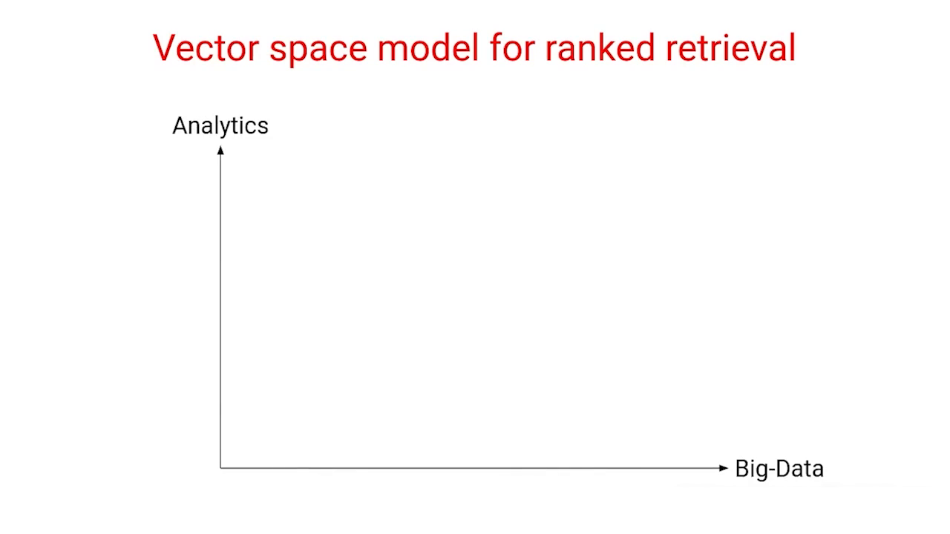

Slide 8
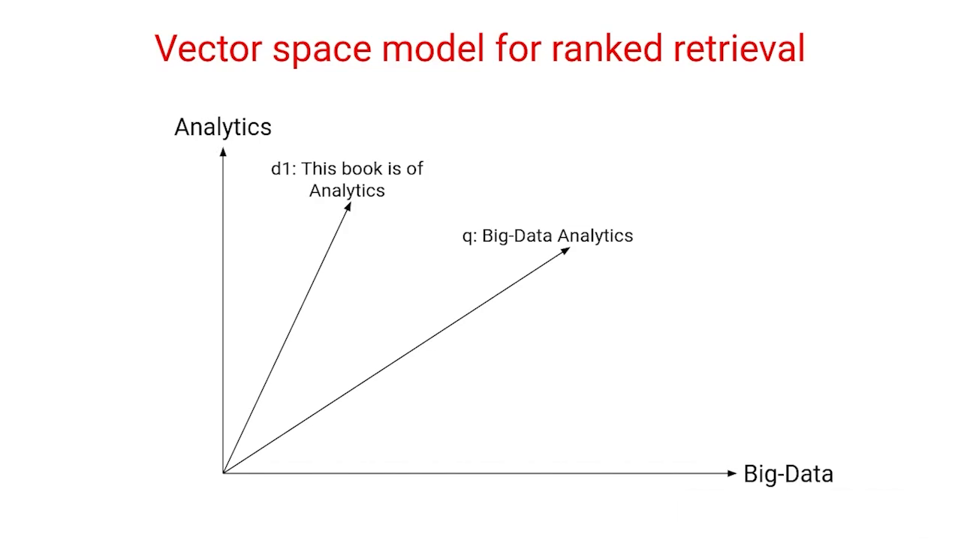

Slide 9
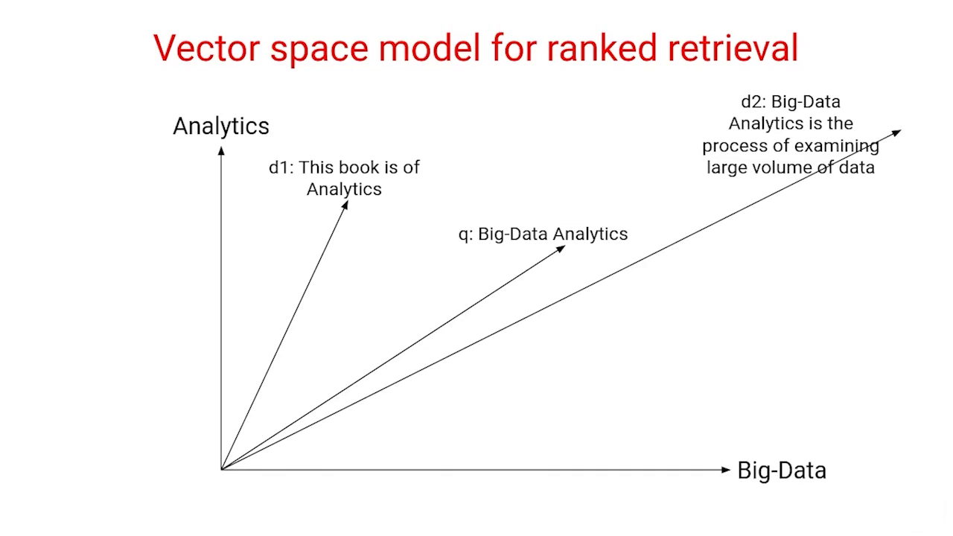

Slide 10
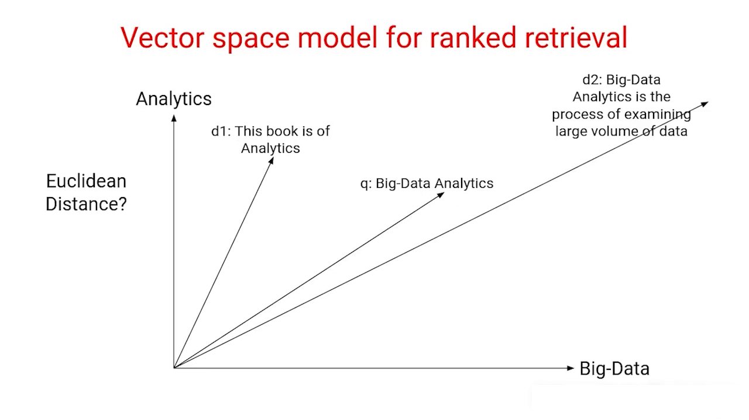

Slide 11
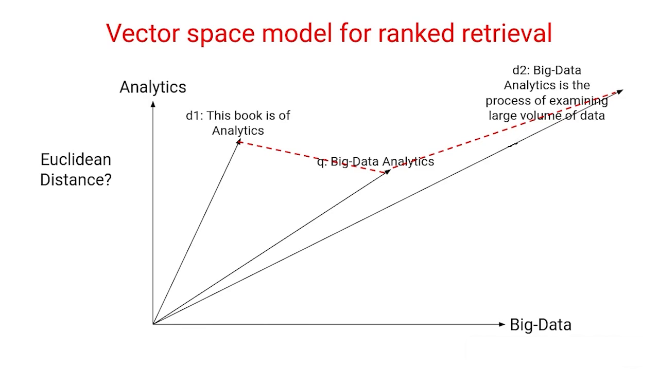

Slide 12
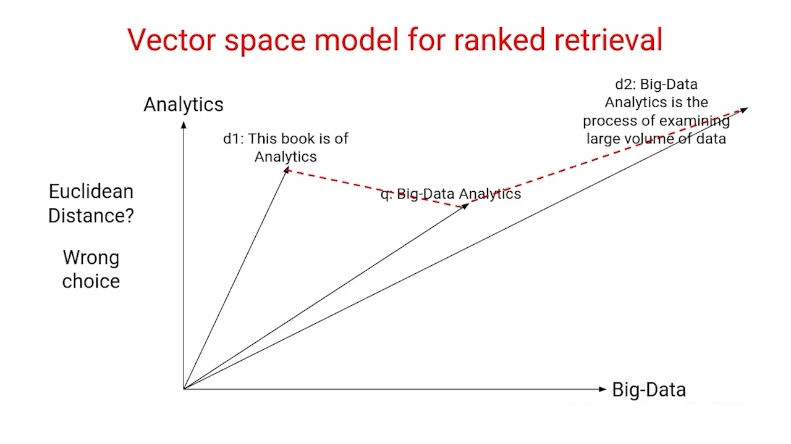

Slide 13
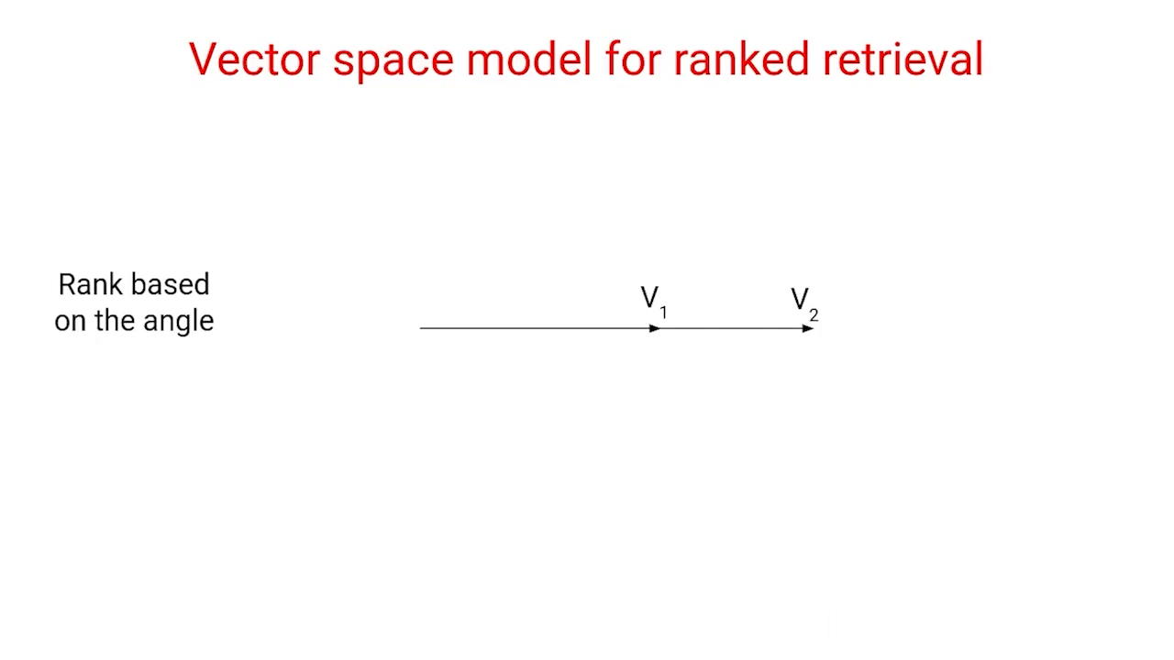

Slide 14
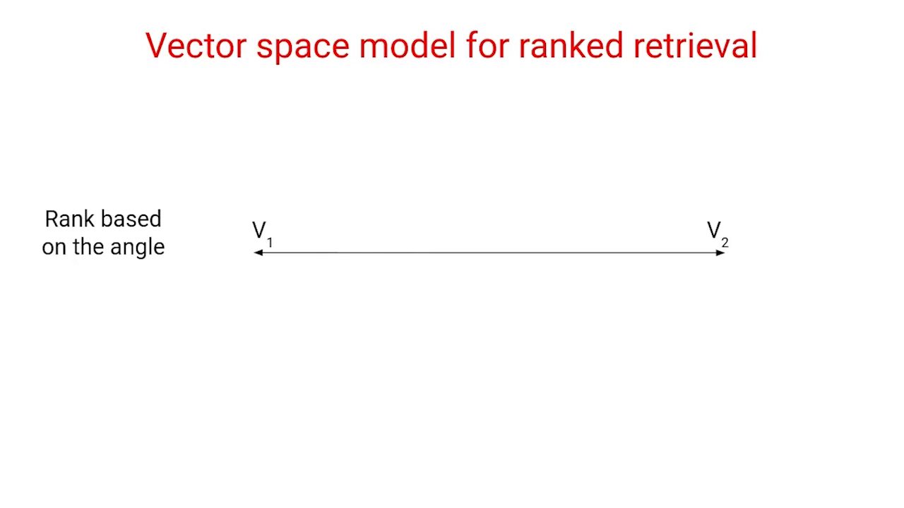

Slide 15
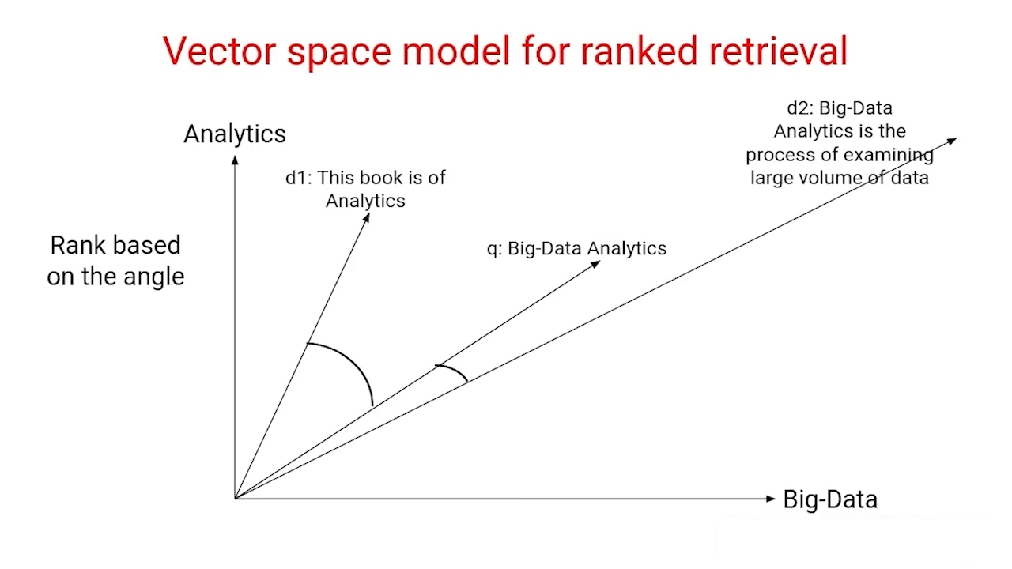

Slide 16
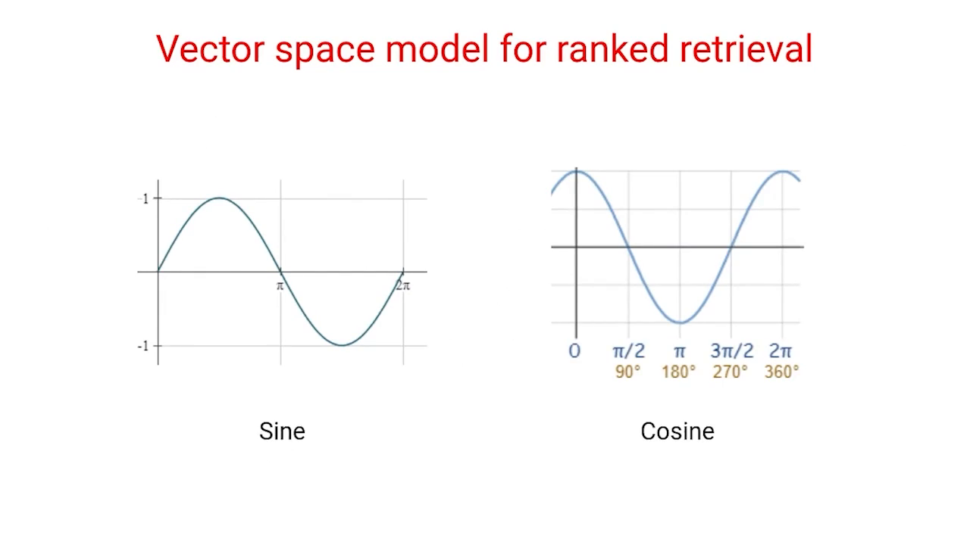

Slide 17
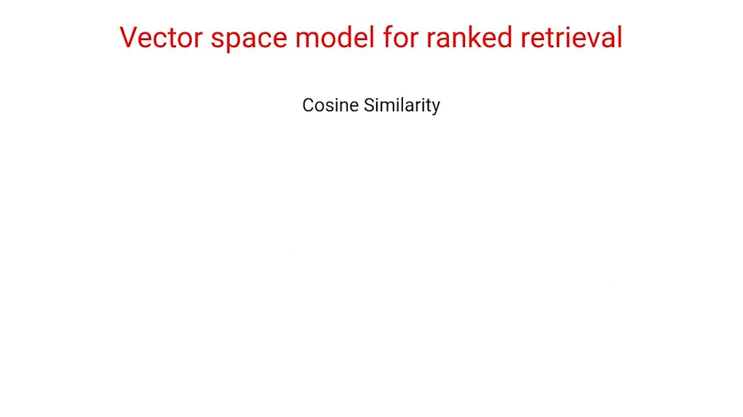

Slide 18
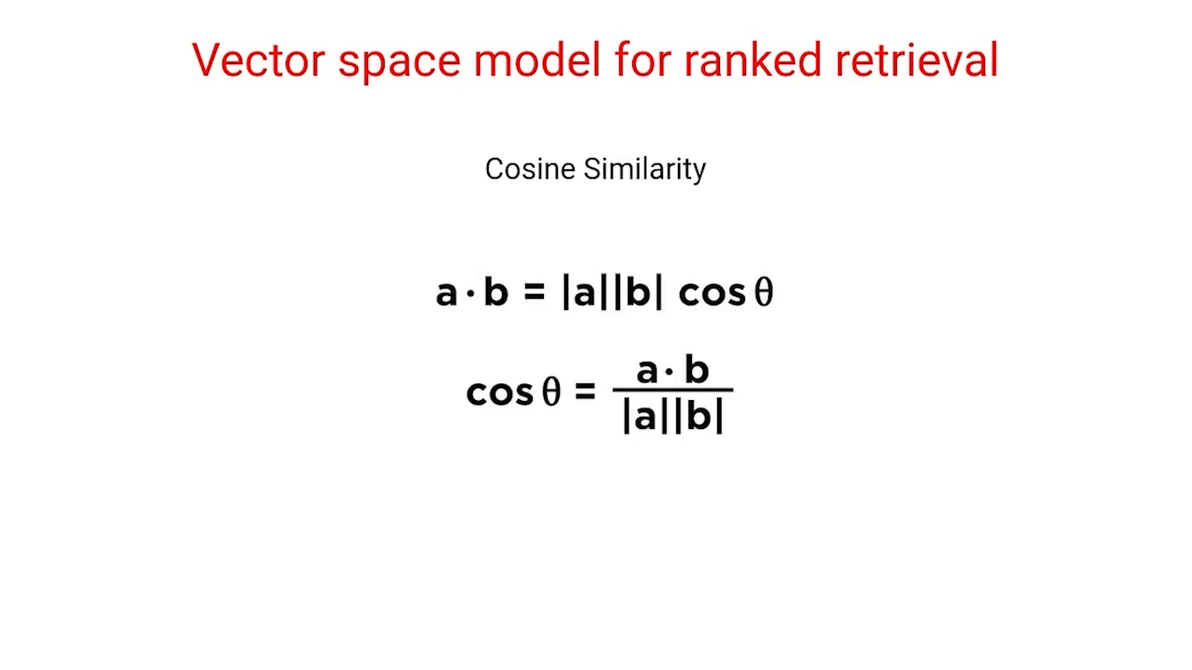

Slide 19
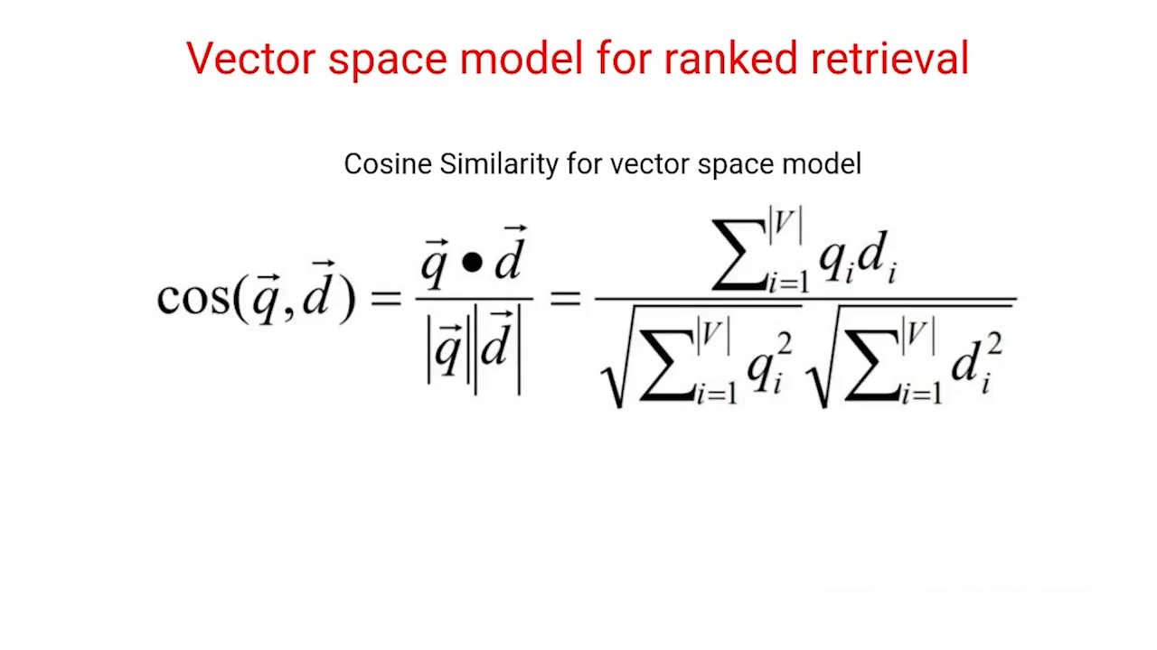

Slide 20
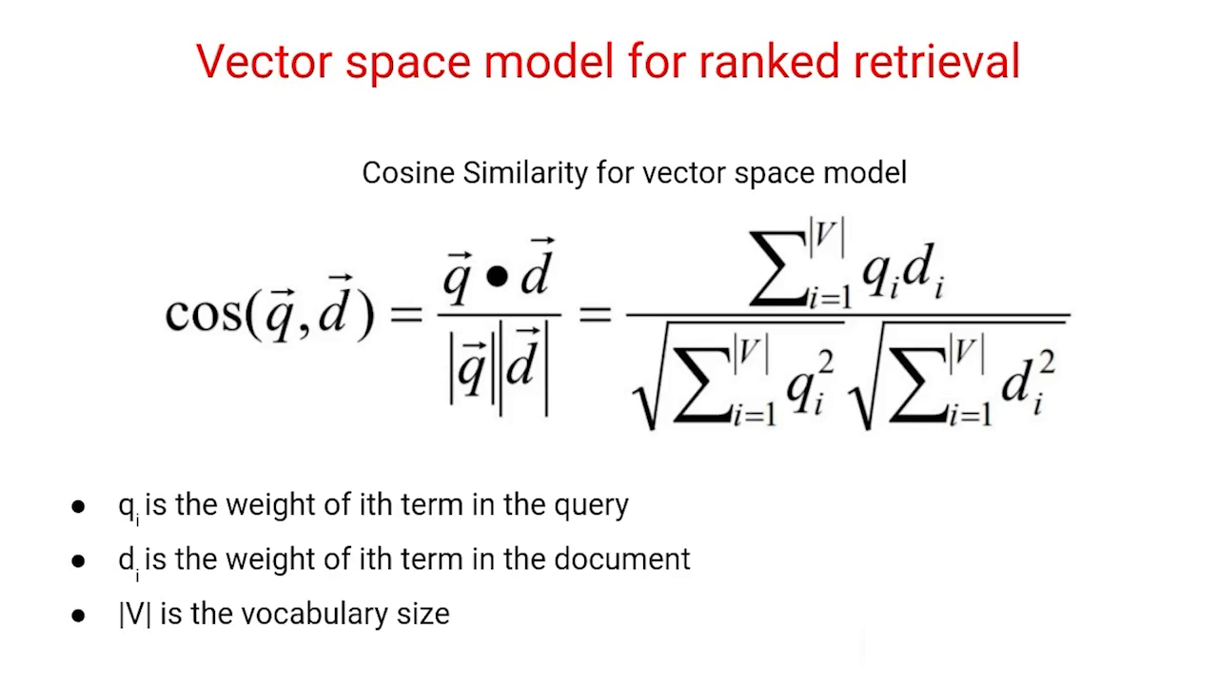

Slide 21
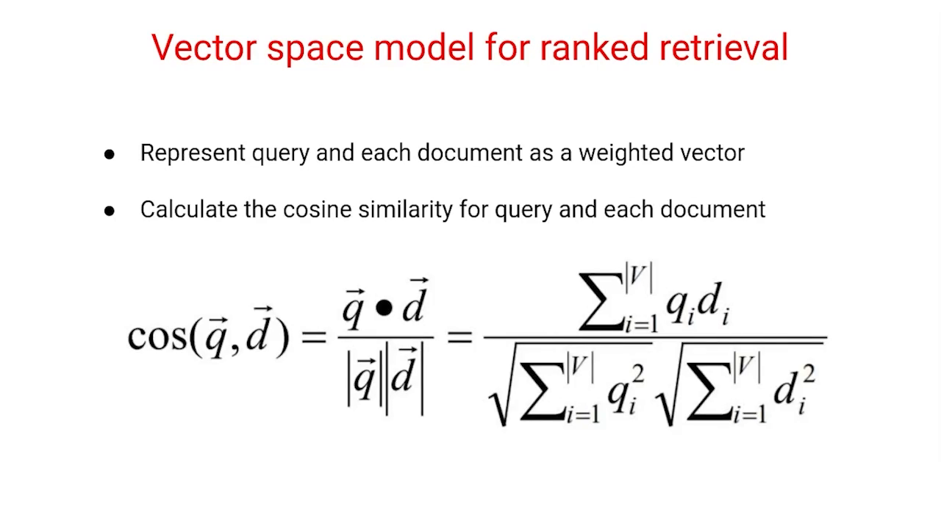

Slide 22
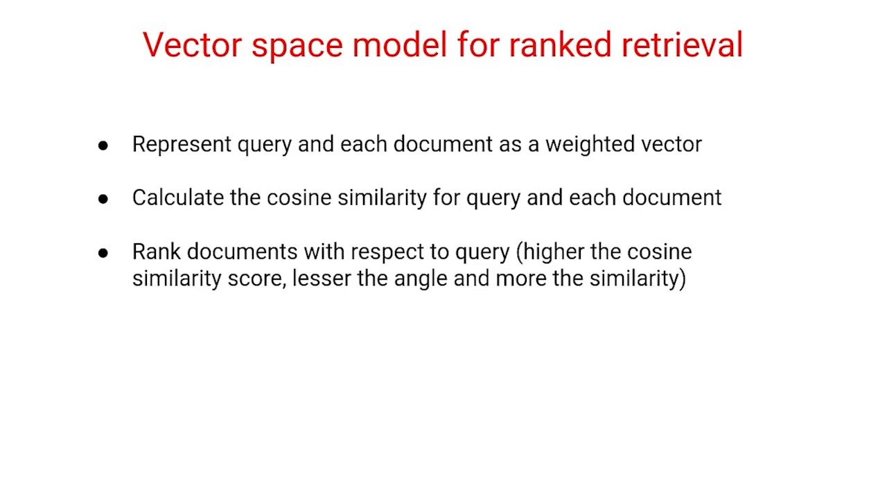

Slide 23
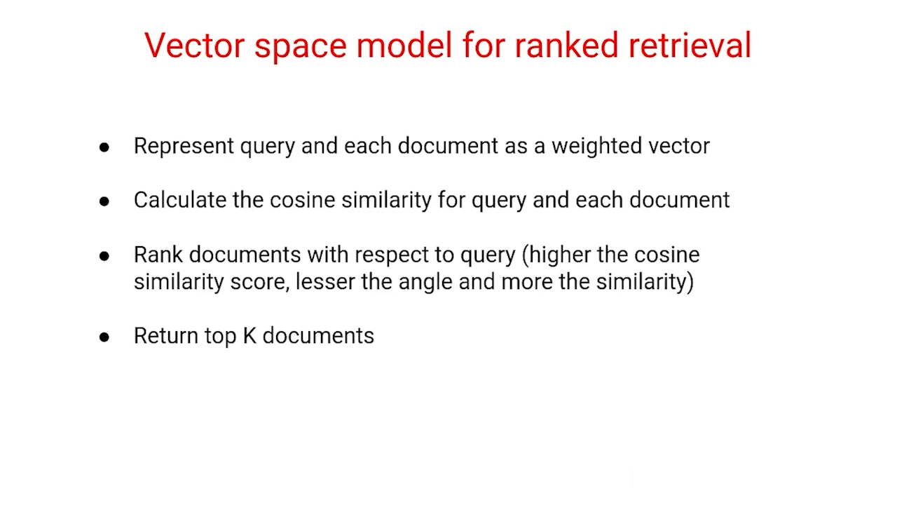

Slide 24
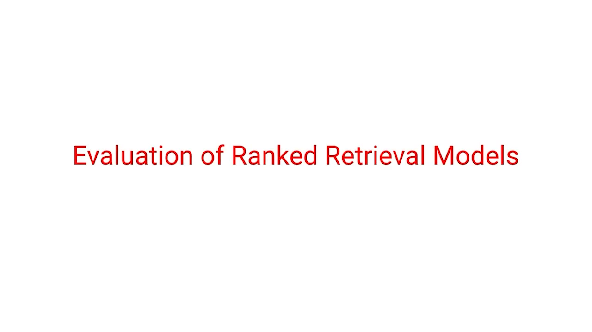

Slide 25
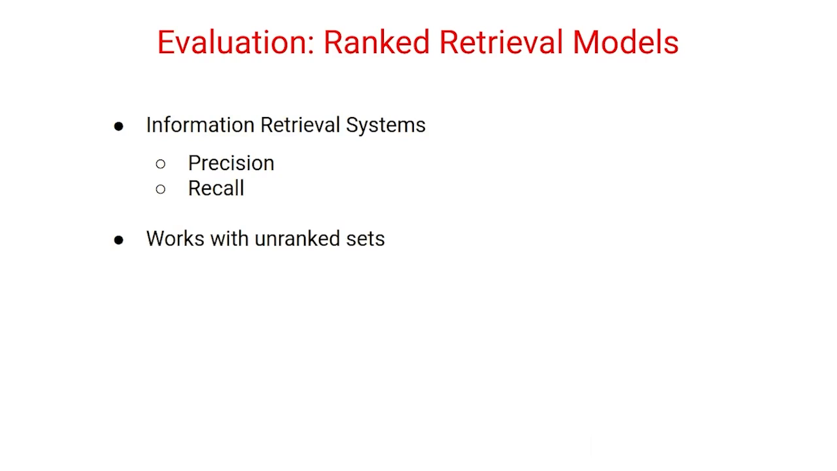

Slide 26
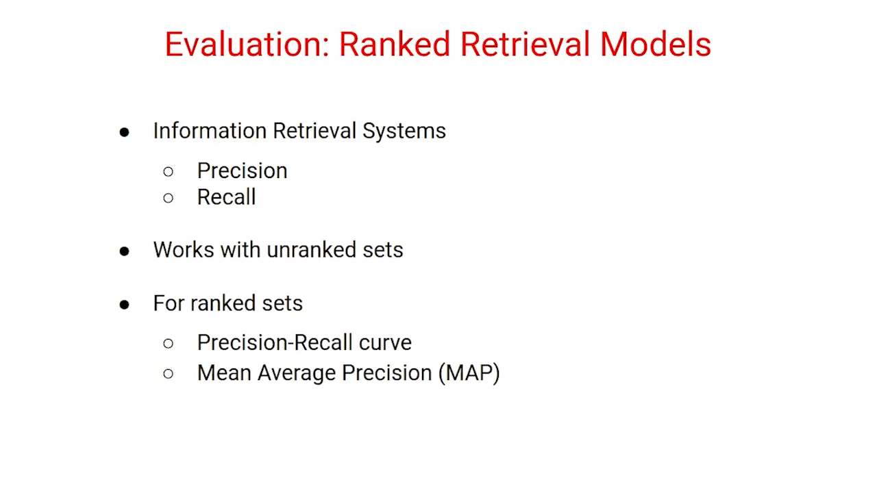

Slide 27
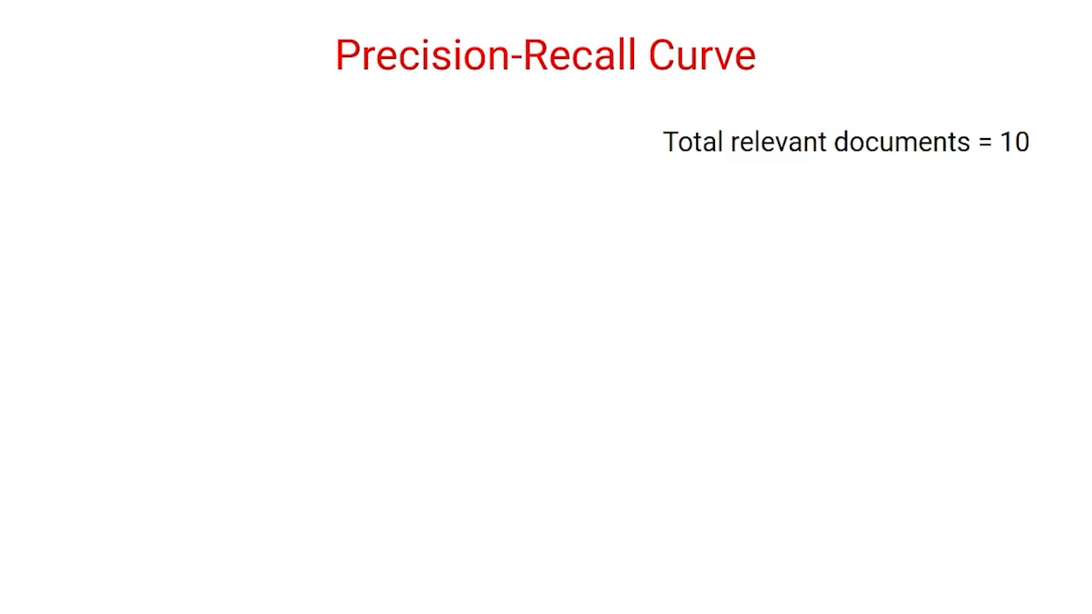

Slide 28
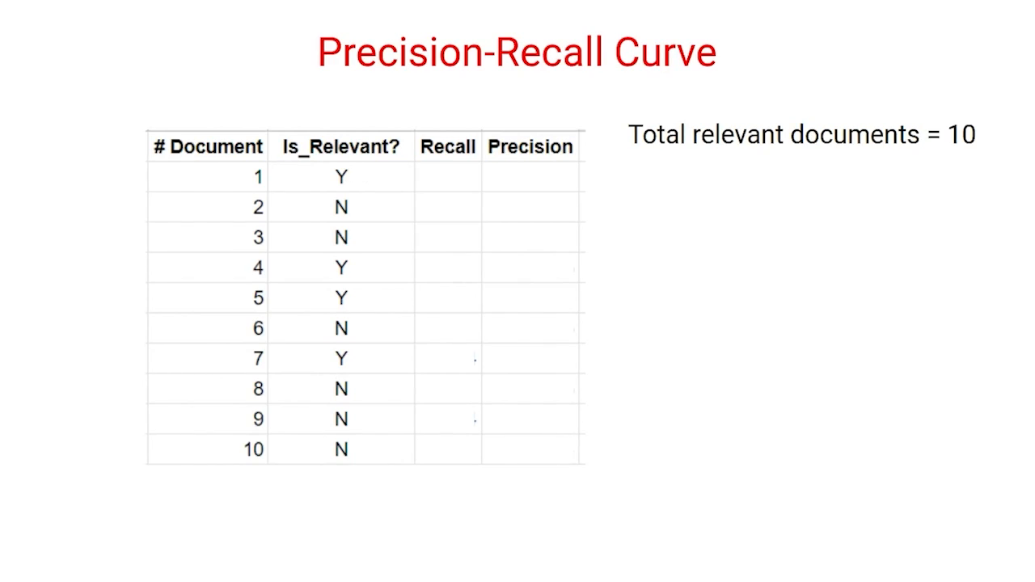

Slide 29
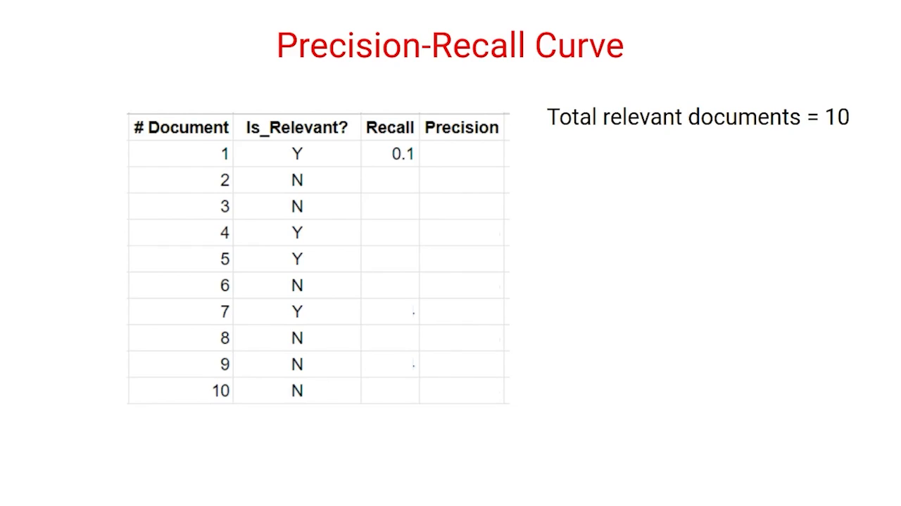

Slide 30
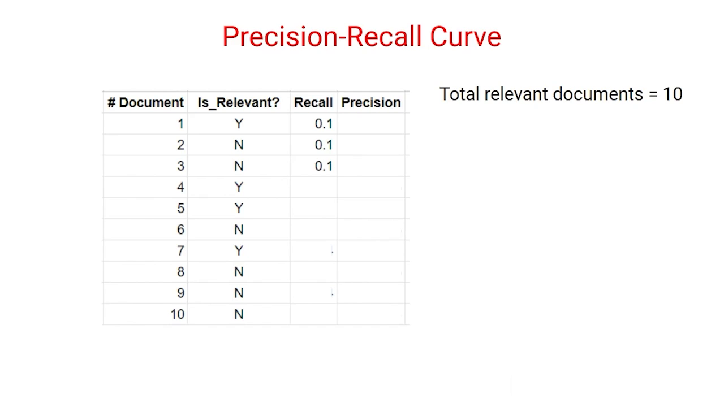

Slide 31
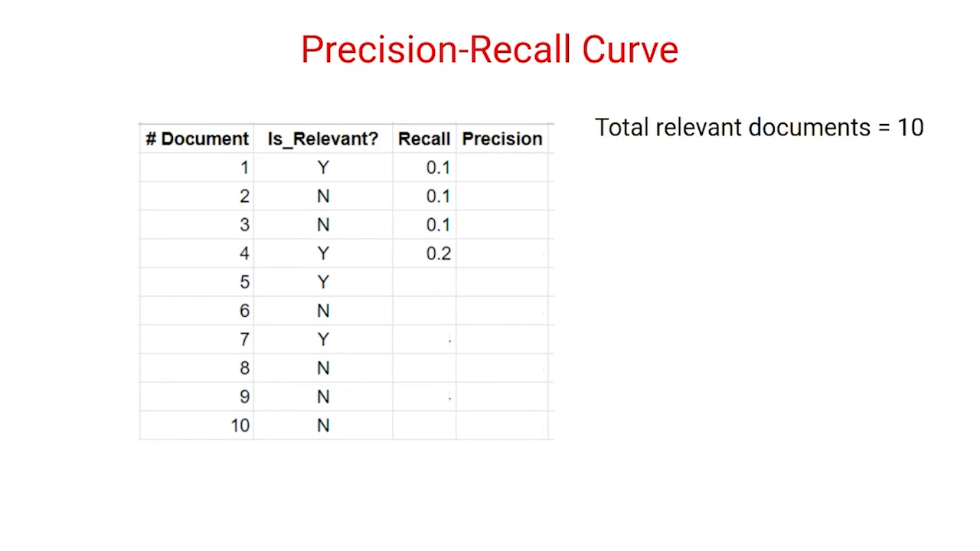

Slide 32
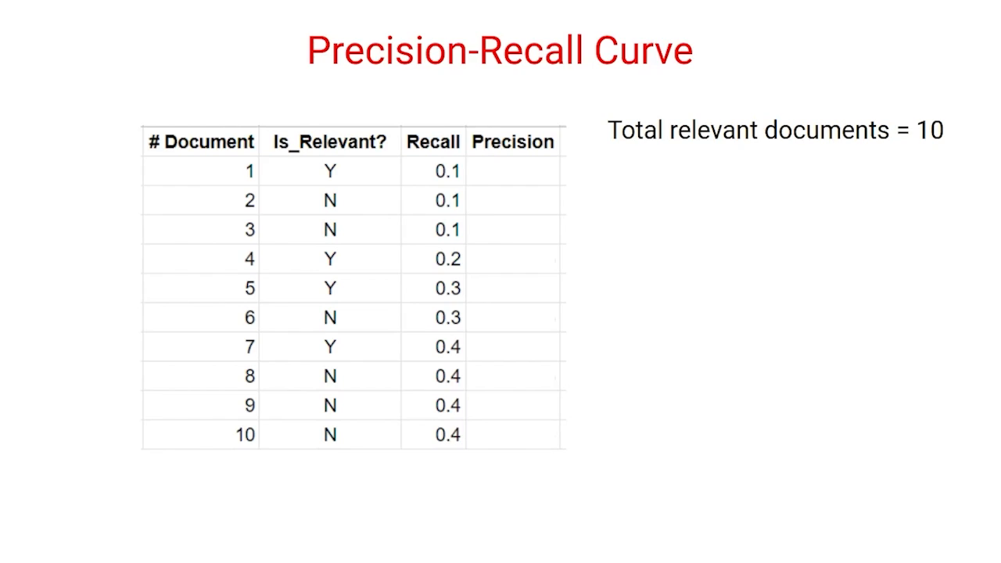

Slide 33
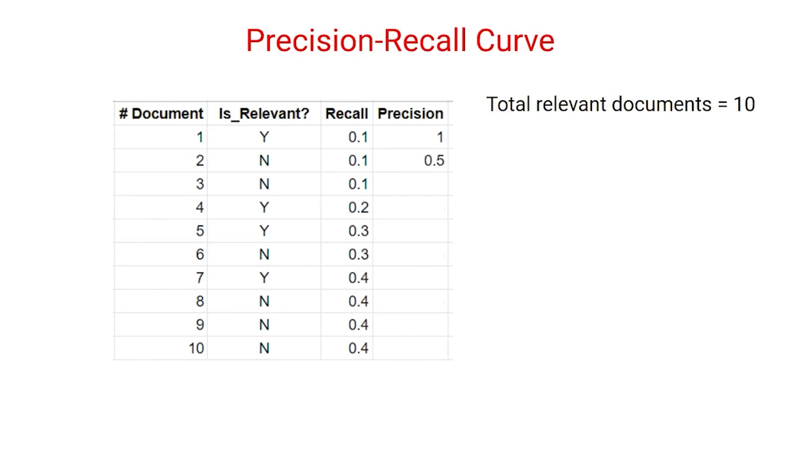

Slide 34
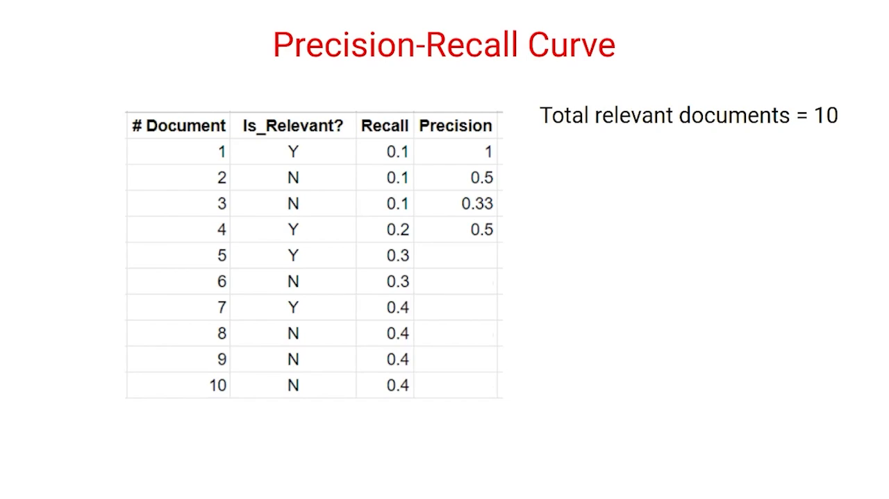

Slide 35
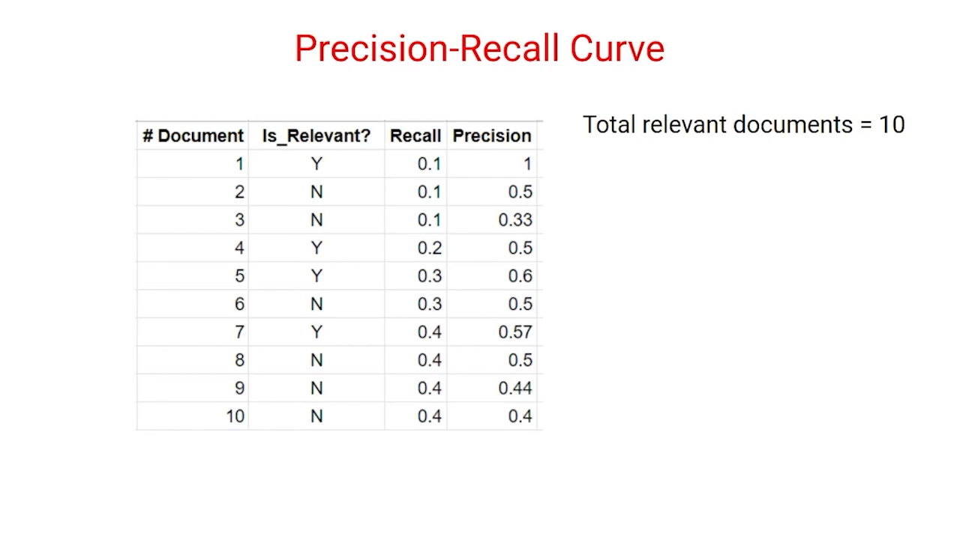

Slide 36
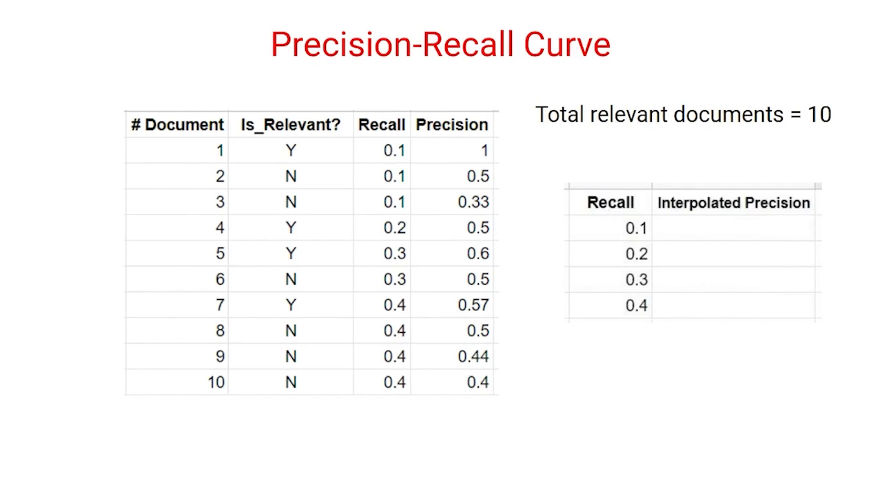

Slide 37
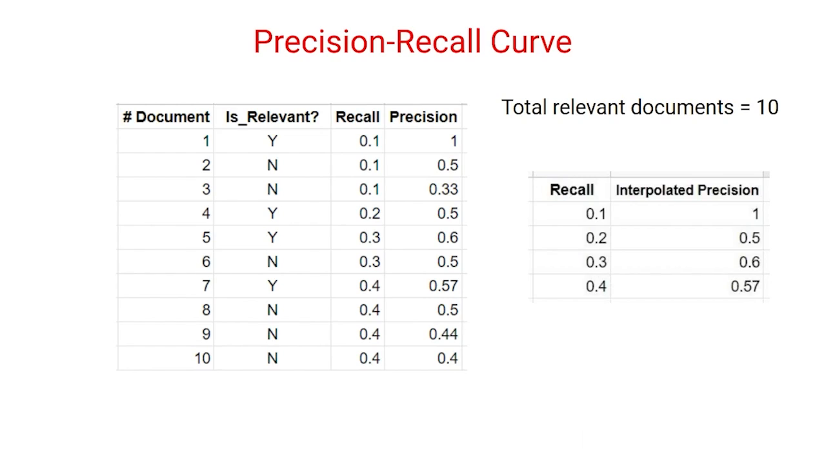

Slide 38
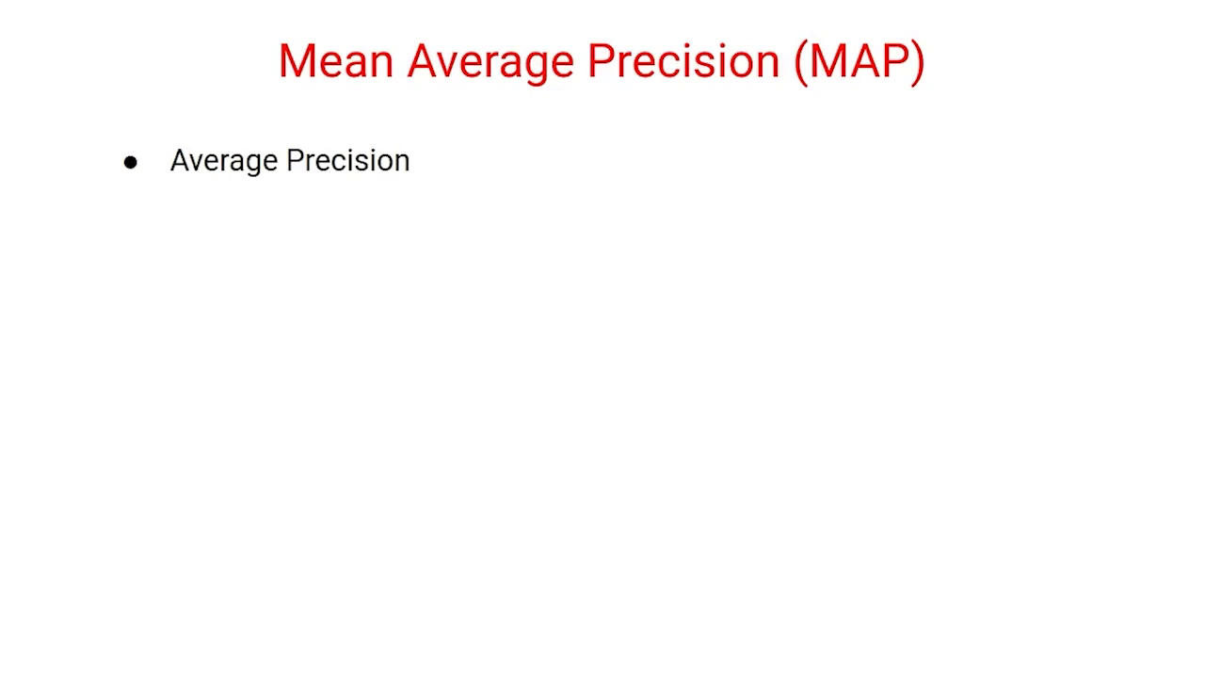

Slide 39
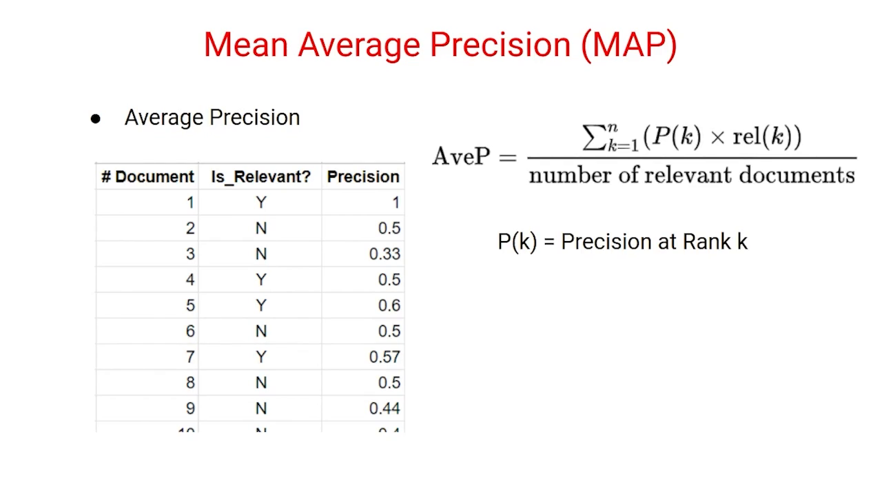
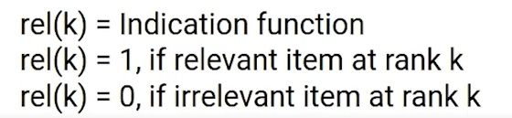

Slide 40
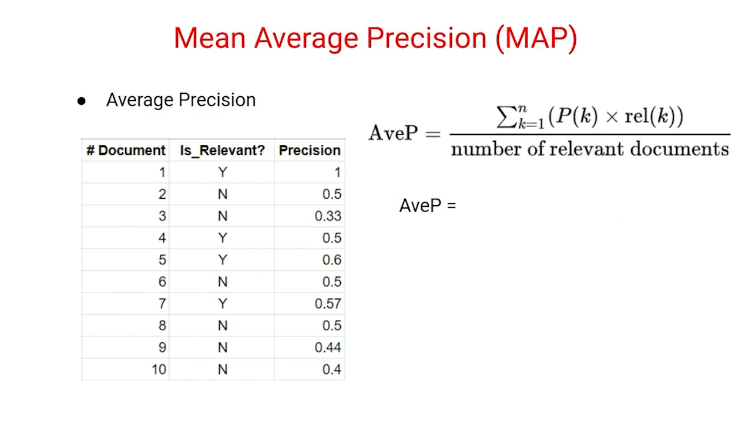
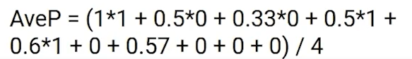
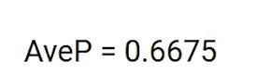

Slide 41
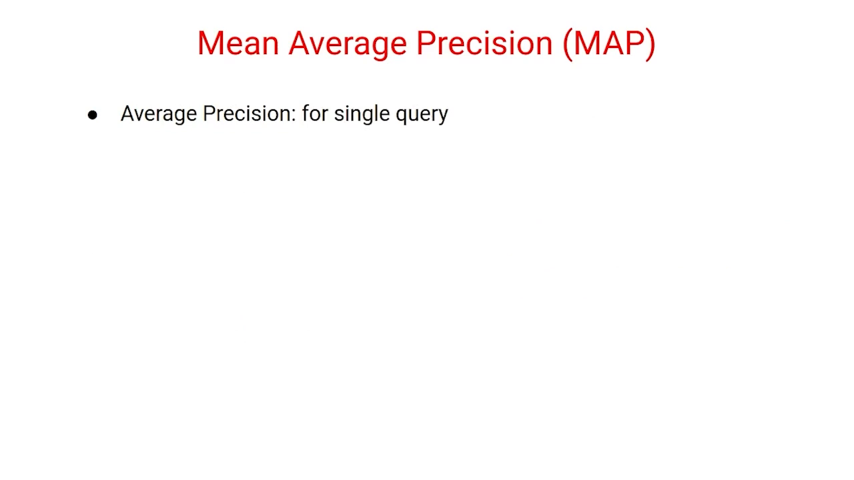

Slide 42
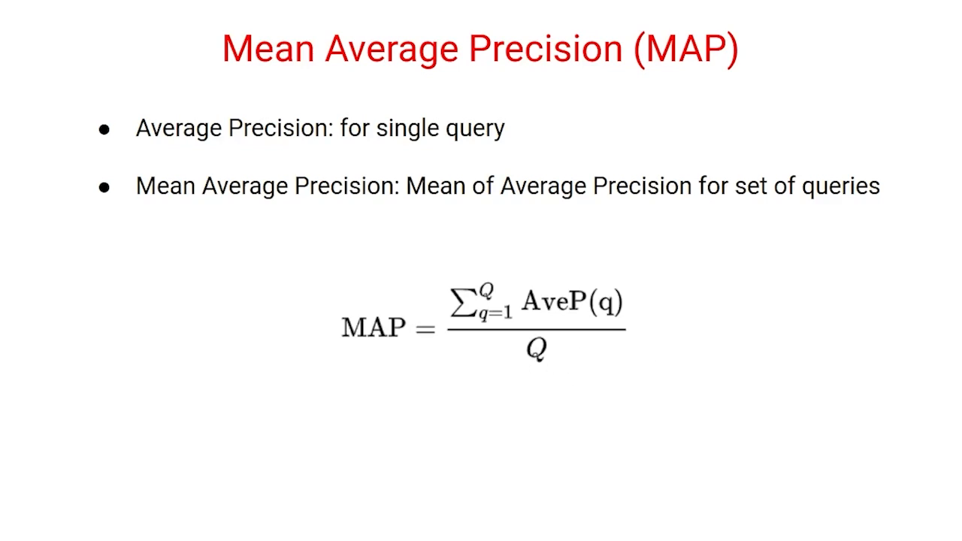

Slide 43

Q. For the precision-recall curve, the value of precision and recall are calculated at each rank.
True
False
Which of the following is/are not correct about Mean Average Precision?
A. P(k) is calculated for the first ten ranks.
B. Average Precision doesn't take precision values of the ranks at which a non-relevant document is present.
C. Average Precision for a query is the average of p(k) for the first ten ranks.
D. Mean Average Precision is the mean of Average Precision for all queries

Slide 44


Slide 45
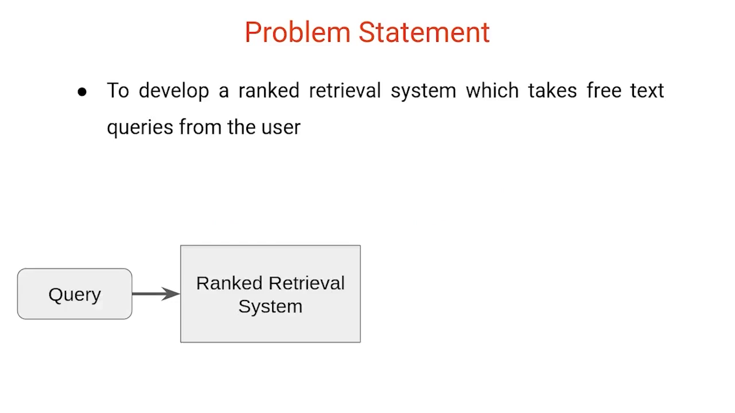

Slide 46
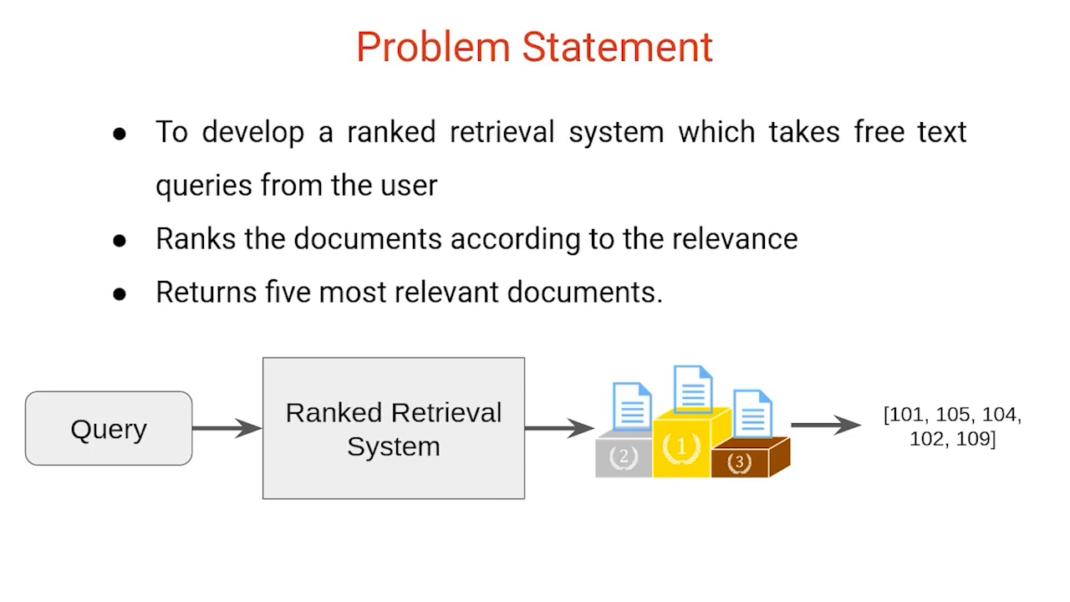

Slide 47
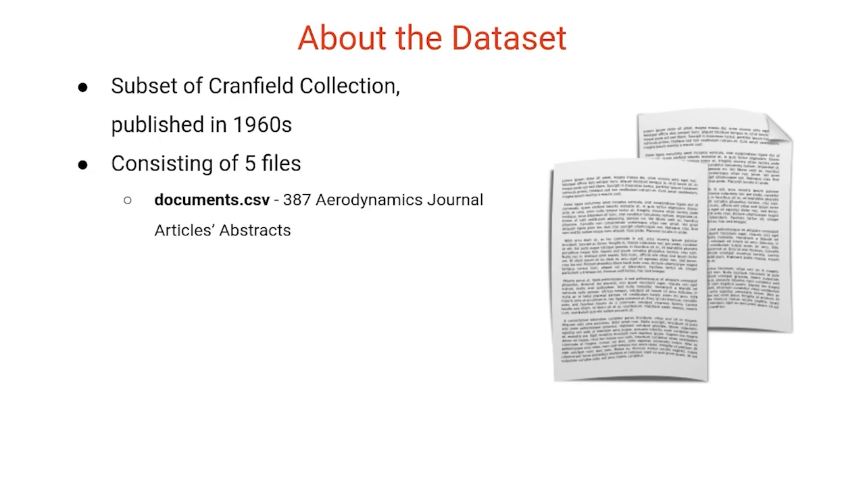

Slide 48
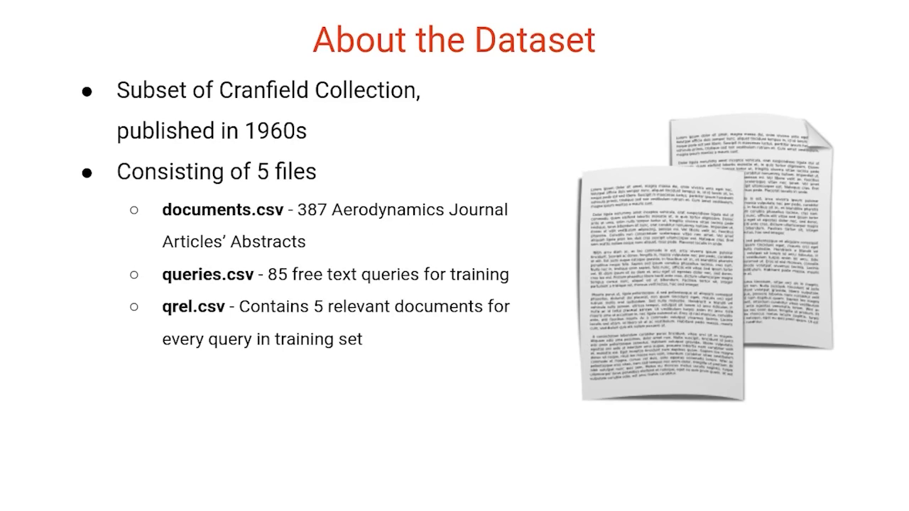

Slide 49
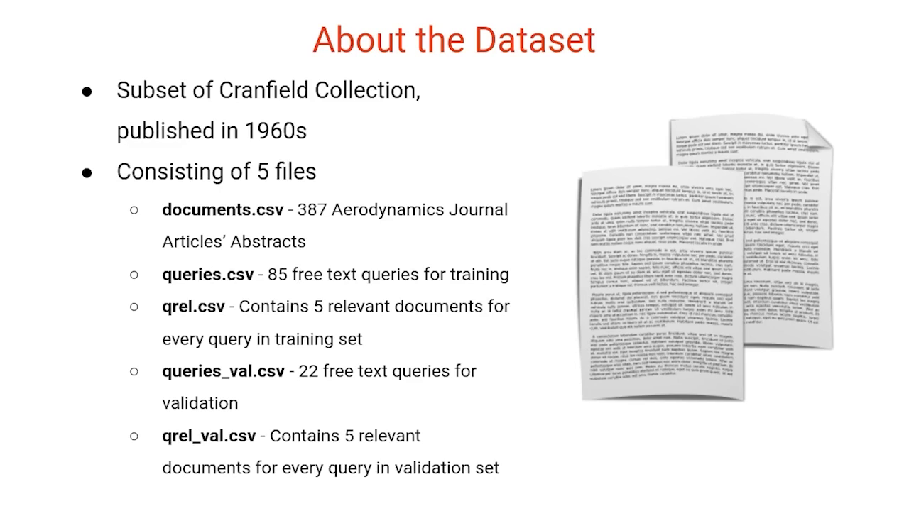

Slide 50


Slide 51


Slide 52


Slide 53


Slide 54


Slide 55


Slide 56
Let’s us take 3 documents to show how this works.
Doc 1: Ben studies about computers in Computer Lab. Doc 2: Steve teaches at Brown University. Doc 3: Data Scientists work on large datasets.
Let’s say we are doing a search on these documents with the following query: Data Scientists
Step 1: Computing the Term Frequency(tf)
tf for document 1:
BEN ->1 , STUDIES -> 1 , COMPUTER -> 2 , LAB -> 1
Vector Space Representation for Doc 1 : [1, 1, 2, 1]
tf for document 2:
STEVE -> 1, TEACHES -> 1, BROWN -> 1, UNIVERSITY -> 1
Vector Space Representation for Doc 2 : [1, 1, 1, 1]
tf for document 3:
DATA -> 1, SCIENTISTS -> 1 WORK -> 1, LARGE -> 1, DATASETS -> 1
Vector Space Representation for Doc 3 : [1, 1, 1, 1, 1]

Slide 57
Normalized TF for Document 1:
BEN -> 0.143, STUDIES -> 0.143, COMPUTER -> 0.2860, LAB -> 0.143
Vector Space Representation for Document 1 : [0.143, 0.143, 0.286, 0.143]
Normalized tf for document 2:
STEVE -> 0.2, TEACHES -> 0.2, BROWN -> 0.2, UNIVERSITY -> 0.2
Vector Space Representation for Document 2 : [0.2, 0.2, 0.2, 0.2]
Normalized tf for document 3:
DATA -> 0.167, SCIENTISTS ->0.167, WORK -> 0.167, LARGE -> 0.167, DATASETS -> 0.167
Vector Space Representation for Document 3 : [0.167, 0.167, 0.167, 0.167, 0.167]

Slide 58

Step 2: Compute the Inverse Document Frequency — idf

Slide 59
Step 3: tf-idf Scoring
n Document3 for the term data, the normalized term frequency is 0.167 and its IDF is 1.5849. Multiplying them together we get 0.2646.

